Slide 1
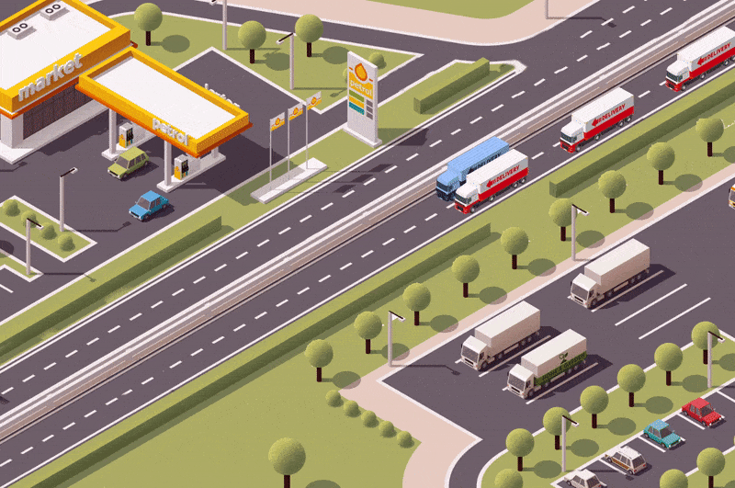
Truck Platooning Autonomous Systems A Lab
(Group B)
Jasmeet Singh Matta
Moshiour Rahman Prince
Shihab Ud Doula
Notes:
Jasmeet

Slide 2
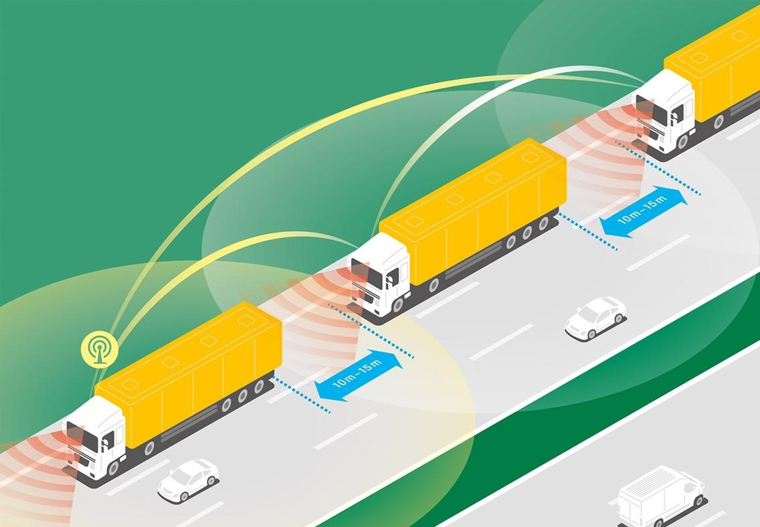
Introduction
Truck platooning: This technique involves multiple trucks driving in close formation, coordinated through communication systems.
Project Goal: Model, simulate and validate truck platooning scenarios
Figure 1: Truck Platooning Concept
Notes:
Jasmeet

Slide 3
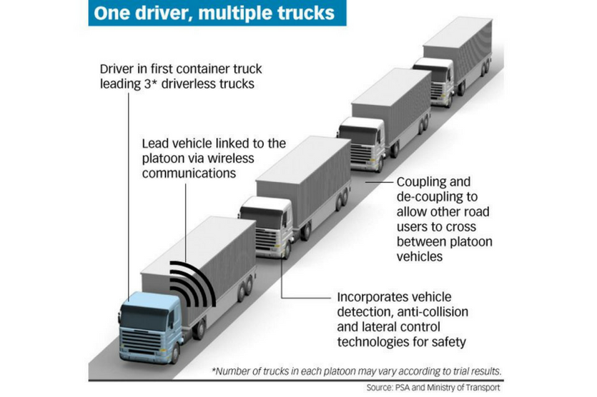
Motivation & Objective
Motivation:
Safety: Reduces accidents.
Efficiency: Lowers fuel consumption.
Traffic Flow: Optimizes road usage.
Objectives:
Model critical driving scenarios.
Ensure system robustness and stability.
Integrate advanced modelling and real-time data processing.
Figure 2: How does truck platooning work?
Notes:
Shihab
Our main motivation was to enhance safety by reducing accidents, improve efficiency by lowering fuel consumption, and optimize traffic flow on the road. To achieve these goals, we set out to model critical driving scenarios, ensure the system's robustness and stability, and integrate advanced modeling techniques with real-time data processing. This will help in creating a reliable and efficient truck platooning system

Slide 4
Identifying Key Scenarios
Obstacle Avoidance: Detect and respond to obstacles.
1
Lane Changing and Steering: Manage lane changes and steering to prevent collisions.
2
Environmental Model: Simulate system behavior in various environmental conditions.
3
Notes:
Shihab
we identified key scenarios that are crucial for truck platooning. These include:
Obstacle Avoidance: The system must detect and respond to obstacles on the road.
Lane Changing and Steering: Managing lane changes and steering to prevent collisions.
Environmental Model: Simulating how the system behaves under different environmental conditions, such as rain or heavy traffic."

Slide 5
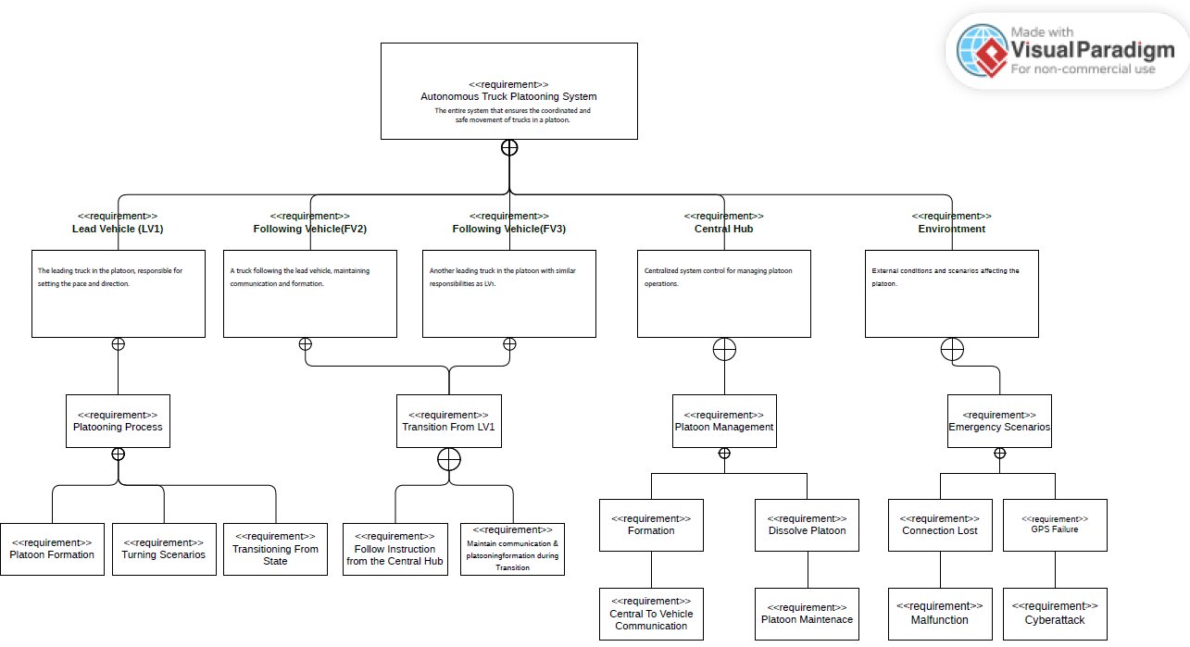
System Design with UML Diagrams
Requirement Diagram: Illustrates system components, including vehicles, central hub, and environment.
Notes:
Prince

Slide 6
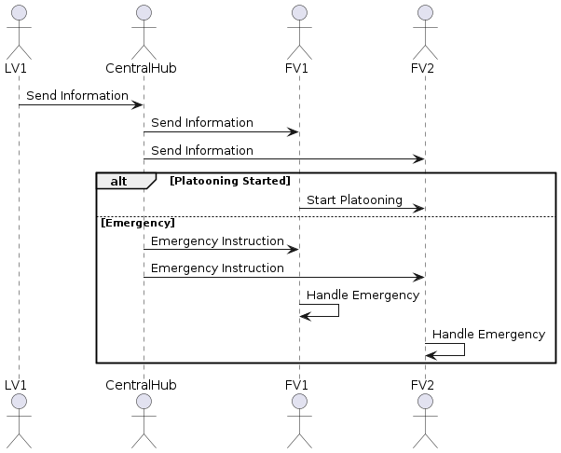
Environmental Model: Response to lost connections and emergencies.
Figure 5: Emergency Handleing
Notes:
Prince

Slide 7
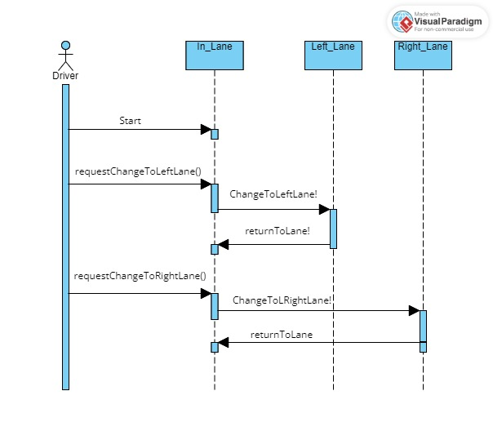
Lane Changing: Process for lane change requests and system responses.
Figure 5: Lane Changing & Steering
Notes:
Shihab
Request: The truck sends a lane change request.
Check Availability: The system checks if the target lane is available.
Approval or Denial: Based on the availability, the system either approves or denies the lane change.
Execute Change: If approved, the truck executes the lane change.
Confirmation: The system confirms the completion of the lane change.

Slide 8
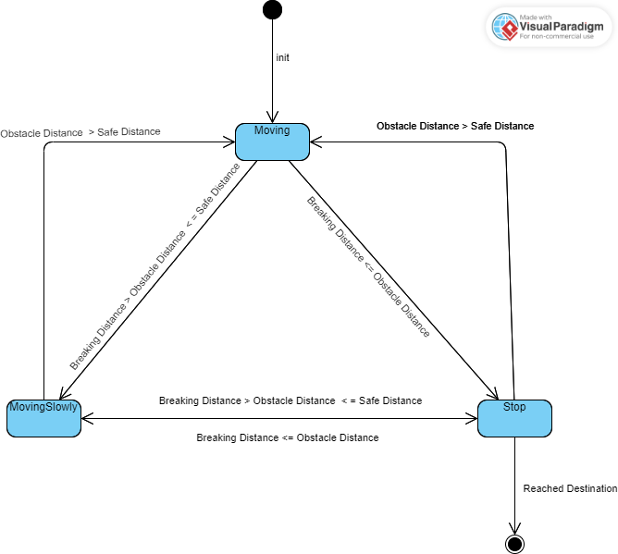
Obstacle Avoidance: State machine diagram for avoiding obstacle
Notes:
Jasmeet

Slide 9
Modeling Scenarios with UPPAAL
Obstacle Avoidance: Truck detects and responds to obstacles.
Lane Changing: Checks lane availability and executes lane changes safely.
System Integration: Combines all scenarios into one cohesive model, ensuring dynamic responses.
Notes:
Jasmeet

Slide 10
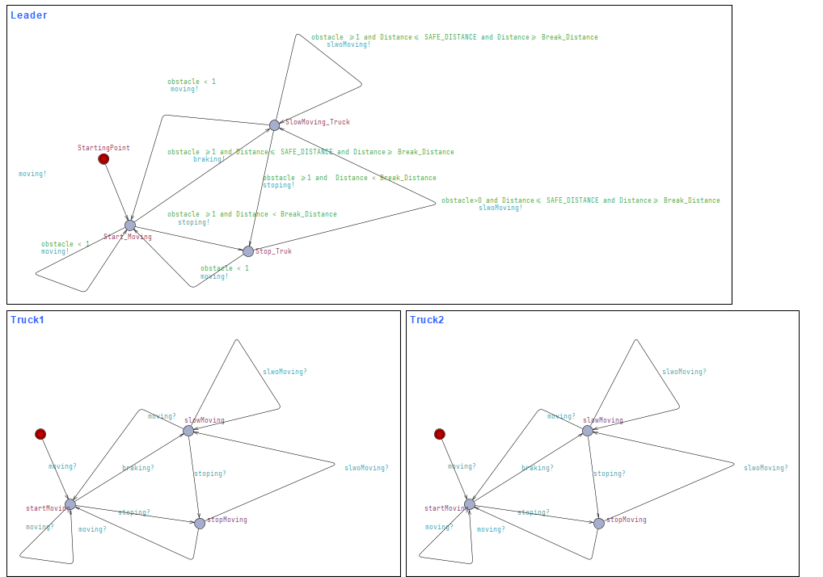
Obstacle Avoidance
Notes:
Jasmeet

Slide 11
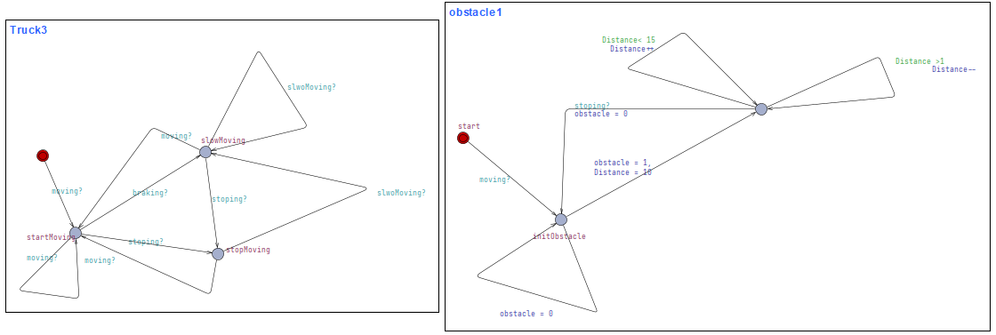
Obstacle Avoidance
Notes:
Jasmeet

Slide 12
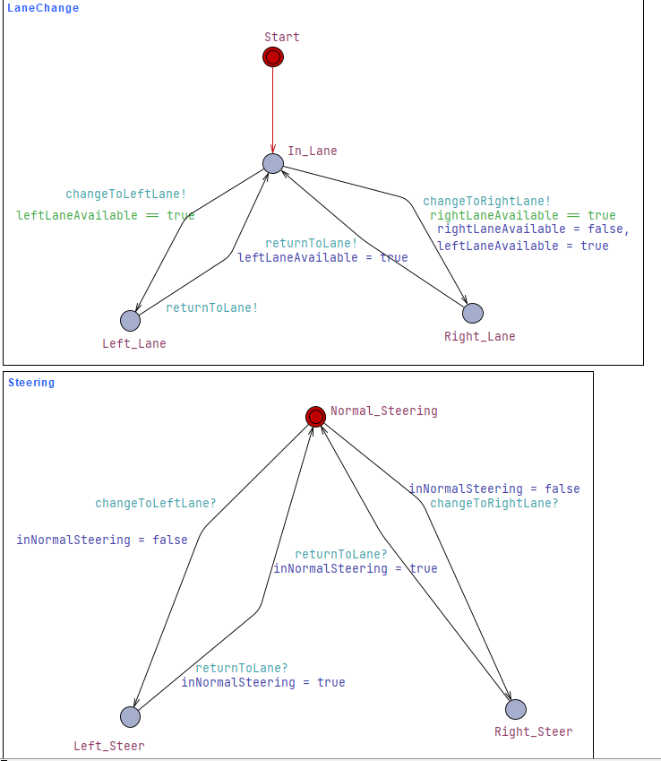
Lane Changing & Steering
Notes:
We start by setting both leftLaneAvailable and rightLaneAvailable to true, allowing initial lane changes.
LaneChange Template:
This template handles lane-changing logic with states like Start, Left_Lane, Right_Lane, and In_Lane.
Transitions between these states are controlled by guards and synchronizations:
For example, changeToLeftLane and changeToRightLane ensure lane changes occur only when the respective lane is available.
Steering Template:
Manages the truck's steering with states such as Normal_Steering, Right_Steer, and Left_Steer.
Transitions are synchronized with lane change requests, ensuring correct steering actions during lane changes.
This model allows us to rigorously test and verify our lane-changing algorithm, ensuring it performs correctly under various conditions

Slide 13
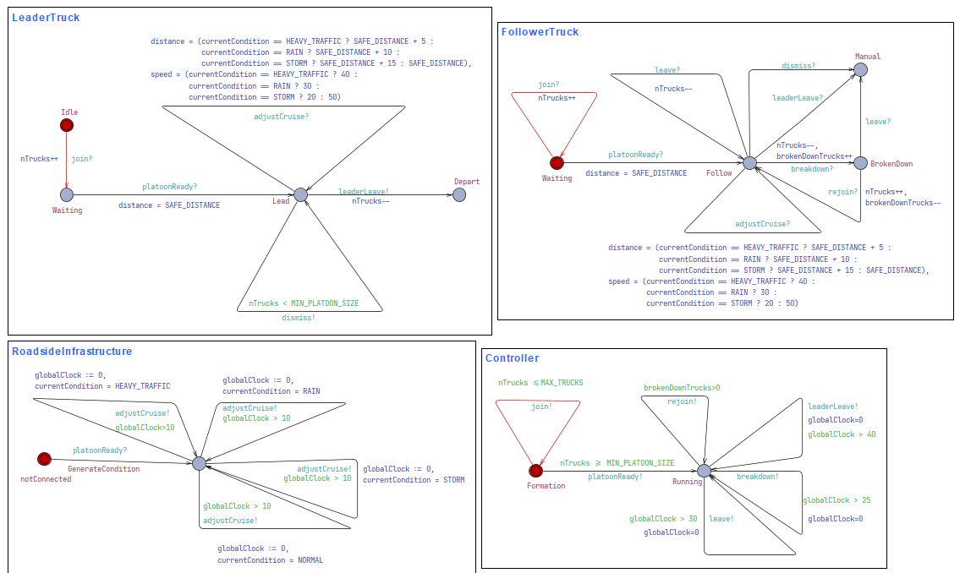
Environmental Model
Notes:
Prince

Slide 14
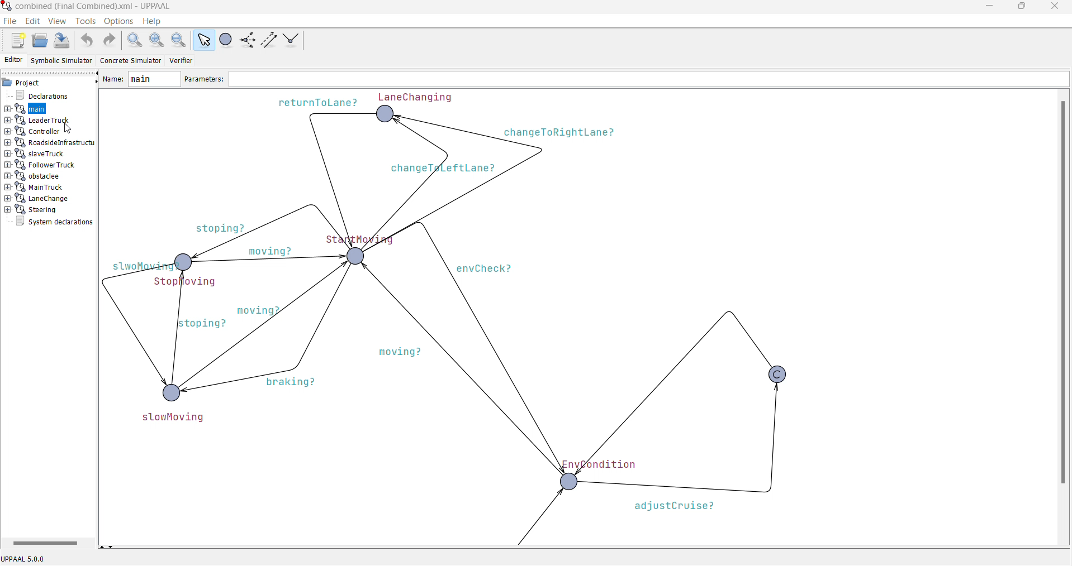
Combined Model

Slide 15

Decision Making with Machine Learning
Leader Vehicle Determination
Implemented a logistic regression using Scikit-learn.
Key Parameters: Years of experience, Aerodynamic Score, Technological score
Training: Splitting a dataset into training and testing data, creating a logistic regression model, and then fitting that model to the training data.
Notes:
Prince

Slide 16
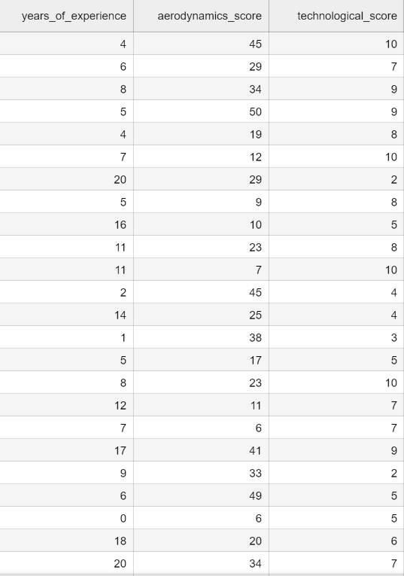

Machine Learning Implementation
Parameters
years_of_experience = (0, 20)
aerodynamics_score = (5, 50)
technological_score = (1, 10)
5000 samples
Notes:
Prince

Slide 17
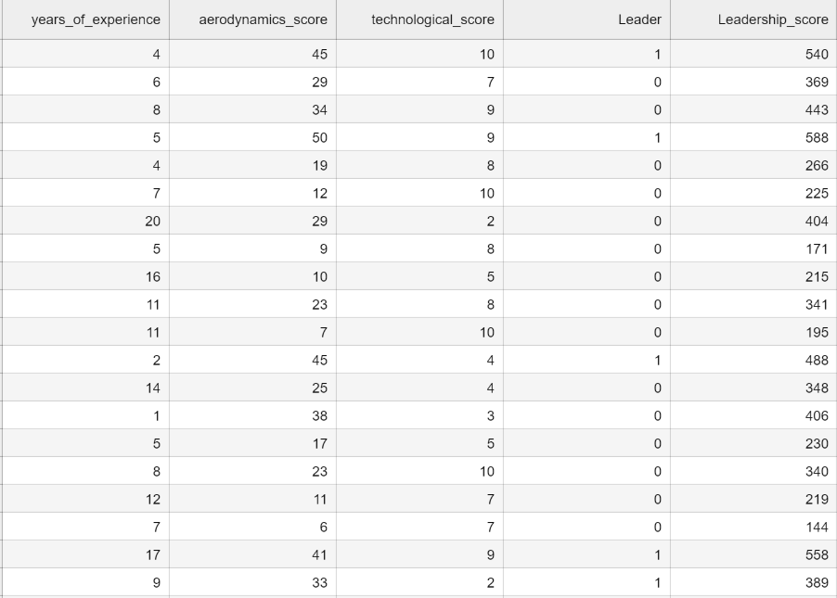
Data Preparation
Score = 𝑤1 ∙ 𝐴 + 𝑤2 ∙ 𝐵 + 𝑤3 ∙ 𝐶
𝑤1= 5; 𝑤2 = 10; 𝑤3 = 7;
A= years of experience
B = aerodynamics score
C = technological score
If score > 450 : leader = True
Notes:
Prince

Slide 18
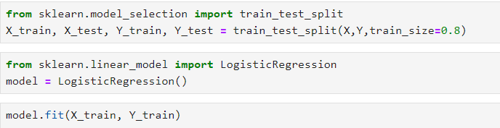
Model Training
Notes:
Prince

Slide 19
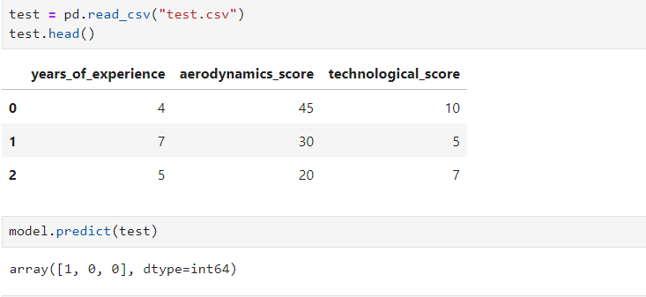
Leader Selection
Notes:
Prince

Slide 20
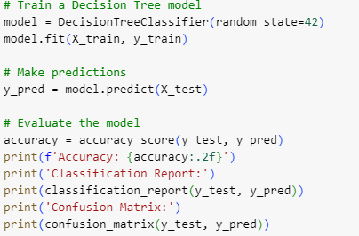
Decision Tree for Leader Vehicle Determination
Accuracy: 87%
Actual \ Predicted | 0 (No Leader) | 1 (Leader)
0 (No Leader) | 642 | 58
1(Leader) | 70 | 230
Notes:
Shihab

Slide 21
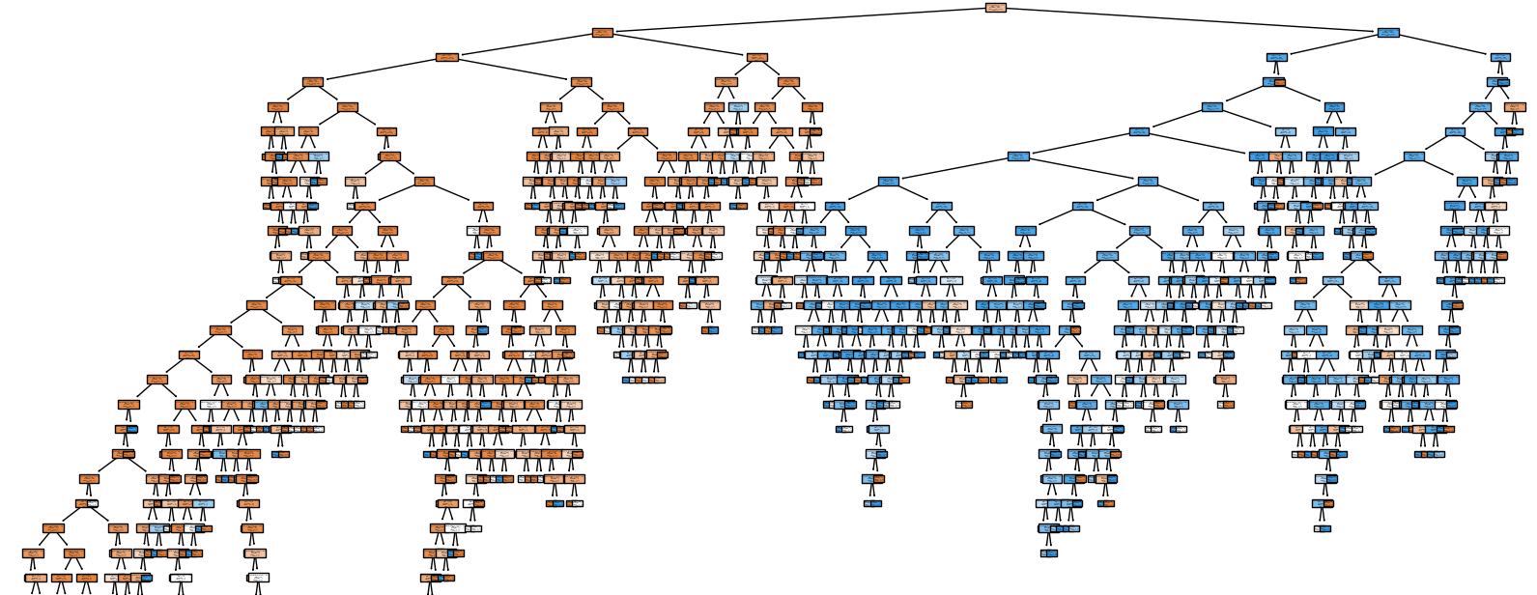
Notes:
Shihab
Step 1: Data Preparation: "First, we loaded the dataset containing various features of the trucks, such as route distance and sensor data. We used only numeric columns for simplicity and split the data into training and testing sets, with 80% for training and 20% for testing."
Step 2: Train the Model: "We then trained a Decision Tree classifier on the training data. This model learns decision rules from the data to classify each truck as either a leader or not."
Step 3: Make Predictions: "After training, we used the model to make predictions on the test data."
Model Evaluation: "We evaluated the model’s performance using accuracy, classification report, and confusion matrix. The model achieved an accuracy of 87%, which means it correctly predicts the leader vehicle 87% of the time."
Confusion Matrix Explanation: "The confusion matrix shows that the model correctly identified 642 non-leader trucks and 230 leader trucks. It misclassified 58 non-leader trucks as leaders and missed 70 leader trucks."

Slide 22
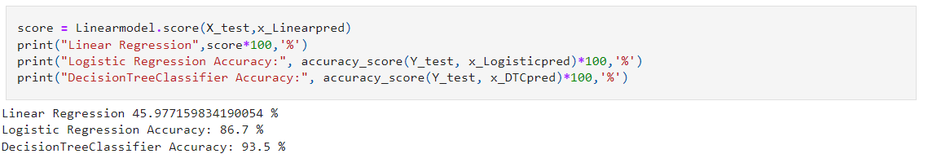
Analysing Solutions
Notes:
Jasmeet

Slide 23

Simulation Environment (Python) need update
Development: Built a simulation environment to test scenarios and the learning algorithm.
Integration: Ensured synchronization of scenarios and the learning algorithm.
Tools: Implemented in Python for real-time data processing.
Notes:
Shihab

Slide 24
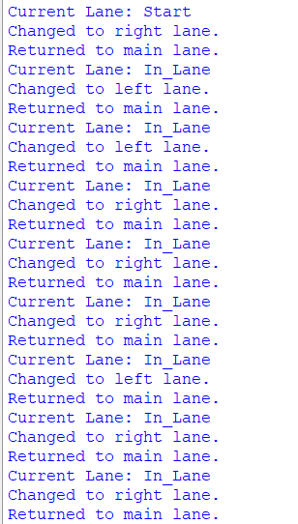
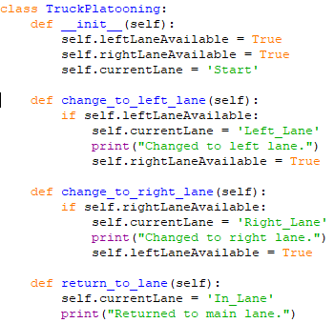
Lane Changing
Simulation Overview:
Demonstrates lane changing based on lane availability
Notes:
Shihab
The main objective was to ensure that lane changes are executed safely and efficiently within a platoon of trucks
The core component is the TruckPlatooning class. This class initializes the state with both lanes available, allowing lane changes. It has three main methods:change_to_left_lane(): Checks if the left lane is available and changes to it.
change_to_right_lane(): Checks if the right lane is available and changes to it.
return_to_lane(): Returns the truck to the main lane after a lane change

Slide 25
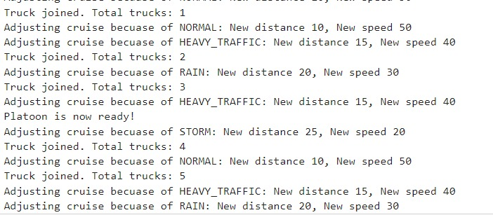
Environmental Changes
Notes:
Prince

Slide 26
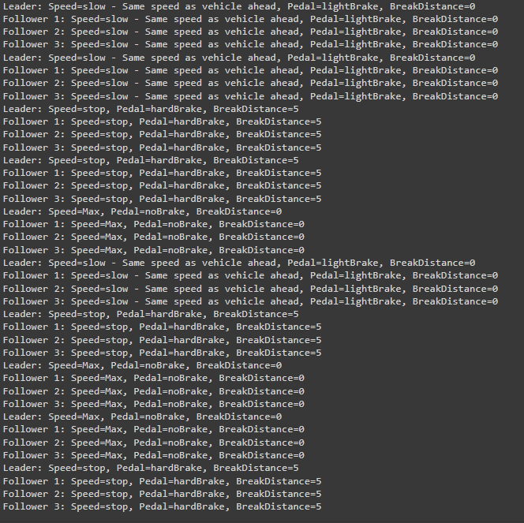
Obstacle Avoidance
Notes:
Jasmeet

Slide 27
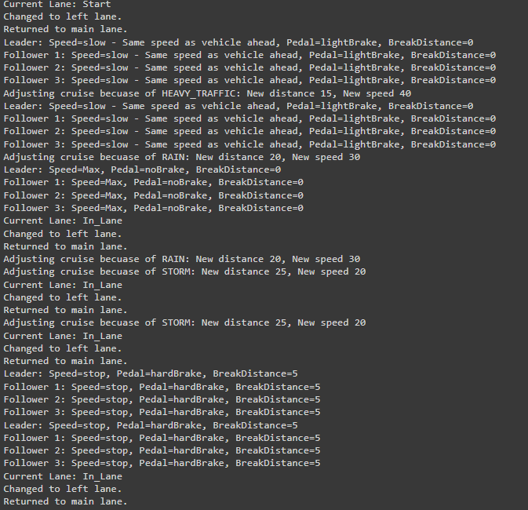
Overall Simulation
Notes:
Jasmeet

Slide 28

Conclusion and Future Work
Modeled and simulated key truck platooning scenarios
Demonstrated integration of UML, UPPAAL, and Python.
Future Work: Potential improvements include enhancing the learning algorithm and expanding the simulation environment.
Notes:
Prince

Slide 29
References
Milford, M. (2017, November 20). Coming soon to a highway near you—truck platooning. The Conversation. https://phys.org/news/2017-11-highway-youtruck-platooning.html
Truck platooning. (n.d.). Rapp AG. https://www.rapp.ch/de/stories/truck-platooning
Designing and Scheduling Cost-Efficient Tours by Using the Concept of Truck Platooning - Scientific Figure on ResearchGate. Available from: https://www.researchgate.net/figure/Basic-mechanisms-behind-the-concept-of-truck-platooning-based-on-Alam-2014-and-Janssen_fig1_338410373 [accessed 4 Jul, 2024]
Deng, Q. (2016). A General Simulation Framework for Modeling and Analysis of Heavy-Duty Vehicle Platooning. IEEE Transactions on Intelligent Transportation Systems, 17(11), 3252–3262. https://doi.org/10.1109/tits.2016.2548502
Duan, D. (2017, November 23). Truck Platooning: the band of Semi-Trailers. Labroots. https://www.labroots.com/trending/chemistry-and-physics/7405/band-semi-trailers-truck-platooning

Slide 30

Questions?

